Slide 1
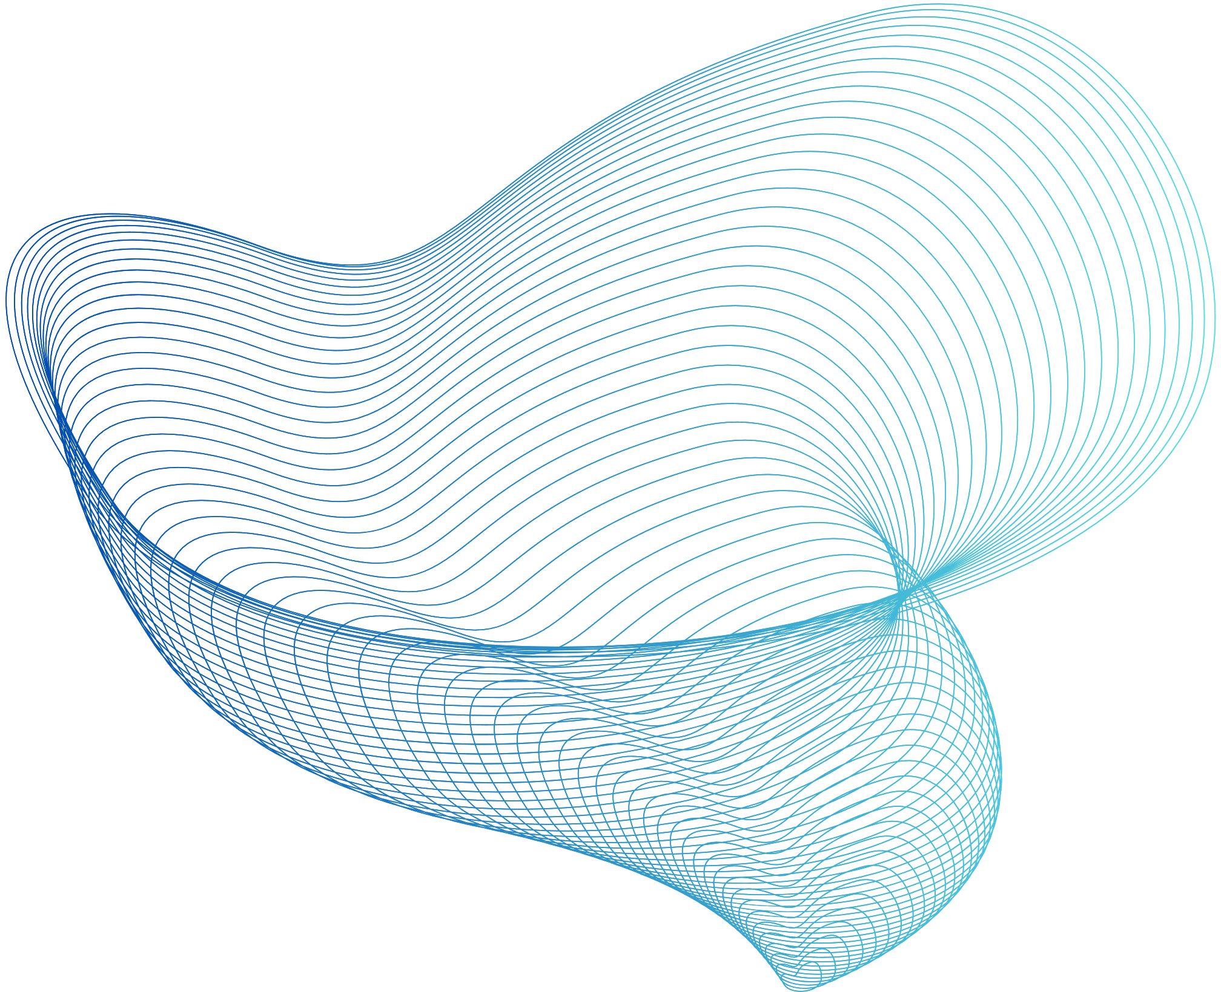

BALL BALANCING BEAM
SIXTH SEMESTER MINOR PROJECT
HARDIK SAHU
2211301122
ANJALI SHARMA
2211301231
SENSOR FUSION BASED ESTIMATION FOR REAL TIME
BALL AND BEAM BALANCING USING LOW COST MICROCONTROLLER

Slide 2
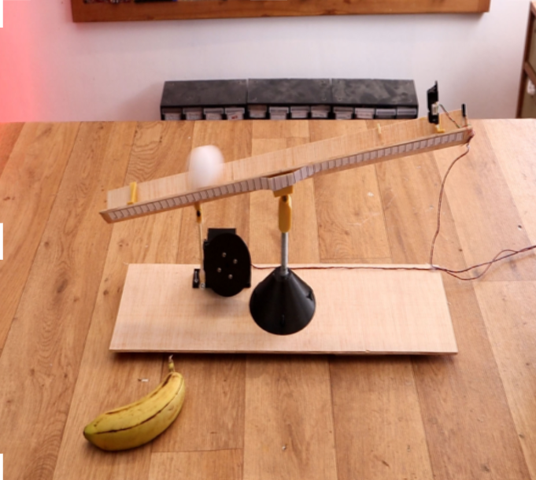
ABSTRACT
This project presents a Ball and Beam Balance System as a practical demonstration of control systems and real-time sensor fusion. The system integrates data from ultrasonic sensors and an inertial measurement unit (IMU) using a Kalman Filter to accurately estimate the ball’s position.
This prototype is ideal for educational and experimental purposes in automation and robotics.

Slide 3
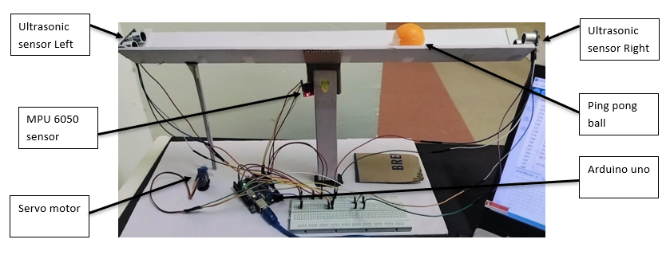
INTRODUCTION
The Ball and Beam system is a classic control problem used to study feedback in unstable systems. The goal is to keep a ball at 25 cm on a tiltable beam using dynamic feedback. We created a cost-effective model to teach sensor fusion, estimation theory, and real-time embedded system design.

Slide 4
SYSTEM ARCHITECTURE:
Software Requirements
Hardware Requirements
•
Component | Specification / Role
Arduino Uno | Microcontroller for real-time control and processing
Servo Motor | Controls beam angle based on control signal
Ultrasonic Sensors (2× HC-SR04) | Measures distance of the ball from each end of the beam
MPU6050 Sensor Module | Measures beam's angular tilt and rate of change
Ping Pong Ball | Target object to be balanced (∼27 grams)
Beam (Foam sheet) | 50 cm long, 4.5 cm wide, forms the platform for the ball
Foam sheet Base | Mounting structure for stable assembly
Power Supply (5V DC) | Provides power to all components
Jumper Wires and Breadboard | Electrical connections for rapid prototyping
Mounts / Hinges | For securely attaching beam to servo
Software | Purpose
Arduino IDE | Programming and uploading code to the microcontroller
Kalman Filter Library | Sensor fusion implementation
Serial Plotter / Monitor | Visualization and debugging of real-time data
MATLAB | Used for simulation, modelling, or Kalman filter tuning of the system
Python (Matplotlib) | For plotting characteristics curve of position with respect to time

Slide 5

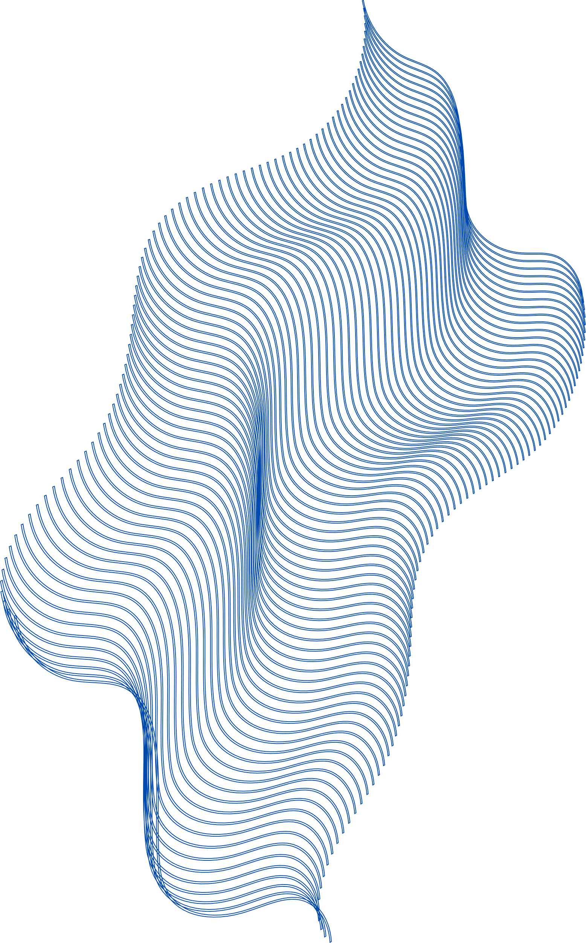
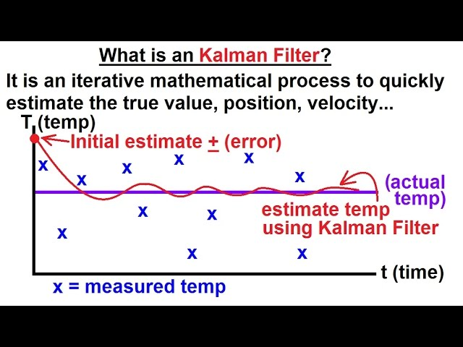
KALMAN FILTER: A BRIEF OVERVIEW:
•• Recursive estimator: Prediction → Update → Correction
•• State Vector: Ball position, velocity, beam angle
•• Benefits: Reduces noise, improves feedback reliability

Slide 6
CONTROL STRATEGY:
•The primary goal is to maintain the ball at the 25 cm reference mark on the beam. An error signal is generated by subtracting the current position from the desired one. Based on this error, the servo motor is commanded to adjust the beam angle. The continuous feedback loop helps the ball settle quickly with minimal oscillations. This strategy can be further optimized using PID control for greater precision and stability.
•• Setpoint: 25 cm
•• Error = Desired - Actual position
•• Control Logic: Drives servo to adjust beam and stabilize the ball
•• Results: Fast and stable convergence

Slide 7
HARDWARE IMPLEMENTATION:
•The beam is constructed from lightweight foamboard, ensuring ease of movement while supporting the ball. A standard ping pong ball is used to test the system. Ultrasonic sensors are mounted at either end of the beam, while the MPU6050 IMU is centered. The servo motor is attached at the pivot to control the tilt. The setup is powered by a USB or a 5V supply and can be assembled easily in a lab or classroom.
•• Beam: Cardboard 2*(50x4.5 cm)
•• Ball: Ping pong ball (27g)
•• Sensors: Ultrasonic at ends, IMU at center
•• Actuator: Servo at pivot
•• Power: 5V via USB or battery

Slide 8

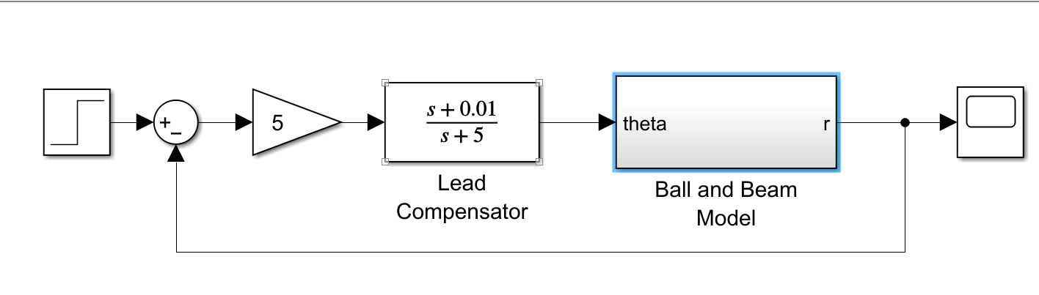
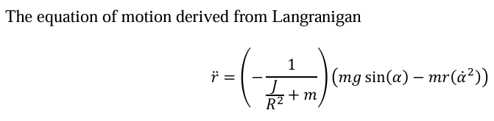
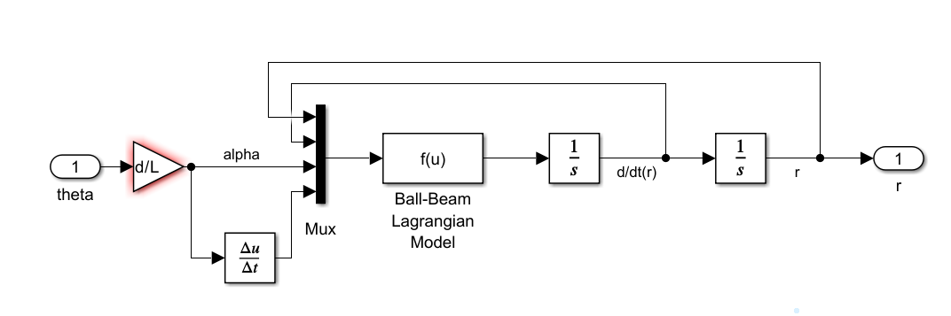
MATLAB SIMULATION

Slide 9
Parameters used in Simulation:
Parameter | Symbol | Value | Units
Ball Mass | m | 0.027 | kg
Ball Radius | r | 1.974 | cm
Moment of Inertia | J | 2/5·m·r² | kg·m²
Beam Length | L | 0.5 | m
Gravity | g | 9.81 | m/s²
Lever Offset Distance | R | 0.045 | m
Parameter | Symbol | Value | Units
Ball Mass | m | 0.027 | kg
Ball Radius | r | 1.974 | cm
Moment of Inertia | J | 2/5·m·r² | kg·m²

Slide 10
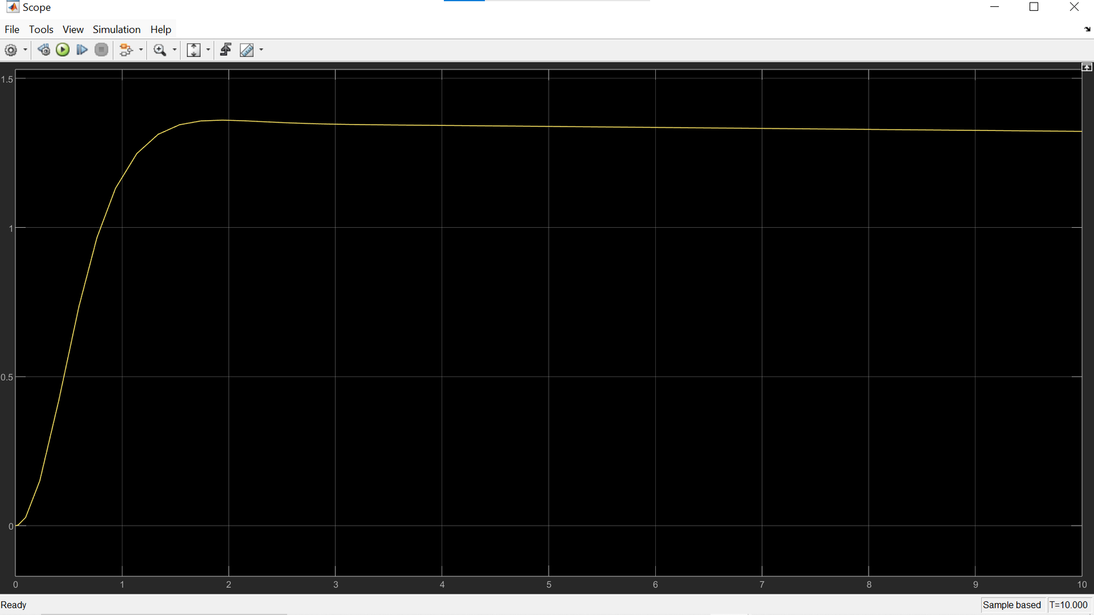
MATLAB SIMULATION
RESULTANT CURVE

Slide 11
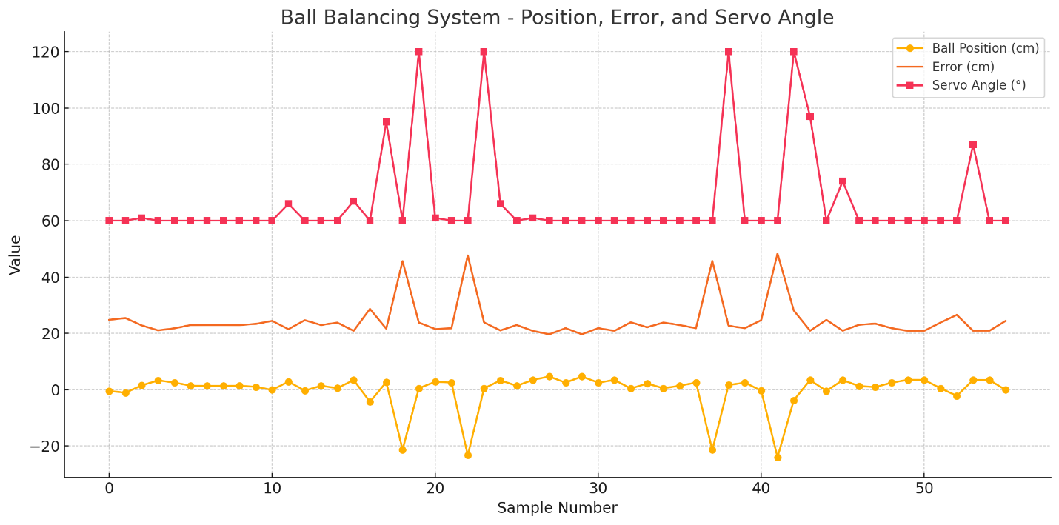
RESULTS OBTAINED
Results Obtained (When Only Ultrasonic Sensors where used)
Observations
Ball Position (cm) fluctuates near the center (target 24.3 cm).
Error (cm) tends to follow the ball position trend with some deviations.
Servo Angle (deg) appears mostly steady with small adjustments, indicating limited actuation.

Slide 12
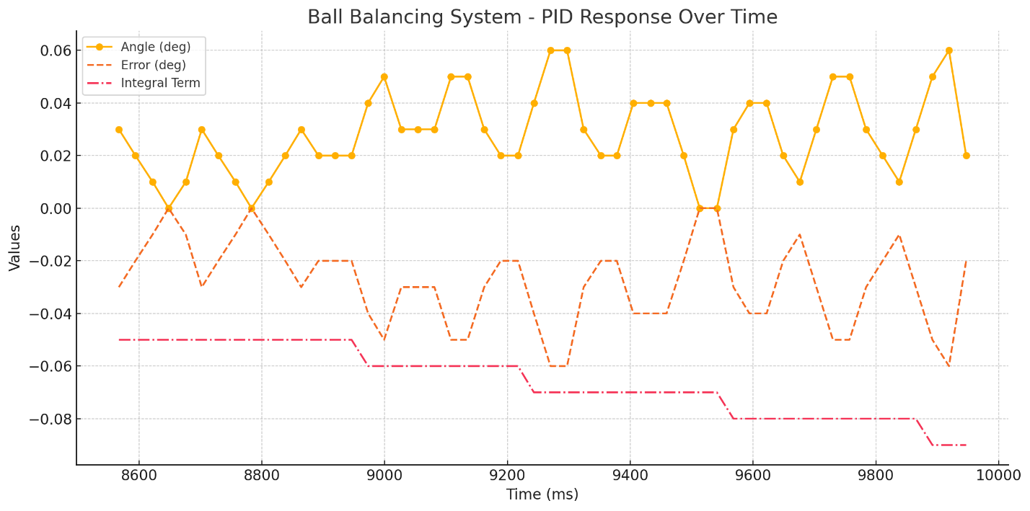
(When Only MPU6050 sensors where used)
Observations:
Stable System Response – Angle remains within 0.02–0.06° range.
Slight Undershoot – Error mostly negative, indicating small steady-state deviation.
Active Integral Term – Gradually decreases to compensate for persistent error.
Well-Tuned PID – No major overshoot or instability observed.
Sensor Noise Evident – Minor oscillations due to unfiltered MPU-6050 data.

Slide 13
(When both sensors are fused along with Kalman Filter)
Observations:
Stable System Response – Angle remains within 0.02–0.06° range.
Slight Undershoot – Error mostly negative, indicating small steady-state deviation.
Active Integral Term – Gradually decreases to compensate for persistent error.
Well-Tuned PID – No major overshoot or instability observed.
Sensor Noise Evident – Minor oscillations due to unfiltered MPU-6050 data.

Slide 14
THANK
YOU

